Slide 1


Navigating Through Flutter
A Comprehensive Guide to Navigation and Routing
Mastering Smooth and Seamless User Journeys
Notes:
Hello everyone, welcome to our session on "Navigating Through Flutter."In this presentation we will cover Types of Navigation, Navigator Widget, Implementing Navigation with Navigator, Utilizing Named routes for Navigation, Handling Navigation Arguments, Building a Tab bar for Navigation, implementing a Bottom Navigation bar and Advanced Navigation Techniques

Slide 2
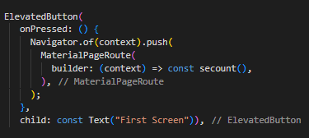
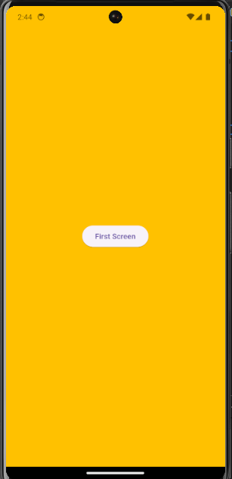
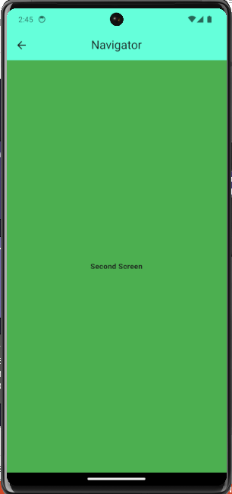
Introduction to Navigation in Flutter
The Art of App Navigation
Navigation is the backbone of a user-friendly mobile app
It guides users through the app's structure and functionality
Flutter provides a powerful navigation system for creating intuitive and seamless user journeys
Types of Navigation
Push Replacement
Push and Remove Until
Push Named
Push NamedAndRemoveUntil
Navigator Widget
The core component for managing app navigation
Handles the stack of screens and transitions between them
Provides methods for pushing, popping, and replacing screens
Notes:
Push Replacement: Replaces the current screen with a new one
Push and Remove Until: Replaces the current screen and removes all previous screens until a specified one
Push Named: Navigates to a specific screen defined by a route name
Push NamedAndRemoveUntil: Navigates to a specific screen and removes all previous screens until a specified one

Slide 3
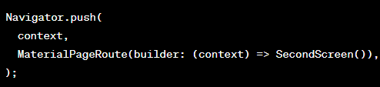
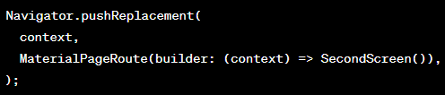
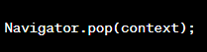
Implementing Navigation with Navigator
Creating Navigation Routes
Define routes using Route configurations
Specify route names for easy identification
Associate widgets with each route to determine the corresponding screen
Navigator.push()
Pushes a new route onto the navigation stack
Transitions to the new screen
Adds the new screen to the navigation history
Navigator.pushReplacement()
Replaces the current route with a new route
Discards the current screen
Transitions to the new screen
Navigator.pop()
Pops the current route from the navigation stack
Transitions back to the previous screen
Removes the current screen from the navigation history
Notes:
Navigator.pop()
Pops the current route from the navigation stack
Transitions back to the previous screen
Removes the current screen from the navigation history

Slide 4

Utilizing Named Routes for Navigation
Benefits of Named Routes
Improved code readability and maintainability
Simplifies navigation logic
Reduces the need for explicit route configurations
Defining Named Routes
Create Route configurations with route names
Associate widget builders with route names
Define route parameters for passing data
Navigating to Named Routes
Use Navigator.pushNamed() to navigate to a specific named route
Pass arguments to named routes using route parameters
Access arguments in the target screen
Notes:
Create Route configurations with route names
Associate widget builders with route names
Define route parameters for passing data

Slide 5

Handling Navigation Arguments
Arguments in Navigator.push()
Specify arguments in the Navigator.push() method
Define a Map or object to hold the data to be passed
Pass the argument Map or object as the second parameter to Navigator.push()
Accessing Arguments in the Target Route
Retrieve arguments in the target route's widget
Access the arguments using the modalRoute.arguments property
Extract the data from the argument Map or object
Passing Data between Routes
Utilize arguments to share data between screens
Pass data from the current screen to the target screen
Allow different screens to exchange information
Notes:
Importance of Data Exchange: Emphasize the crucial role of arguments in facilitating communication and data sharing between different screens in your Flutter app.
Passing Data: Explain how to effectively pass data from the current screen to the target screen using arguments within the Navigator.push() method. You can mention both simple data types and complex objects/maps.
Accessing Arguments: Guide the audience on retrieving arguments in the target route's widget using the modalRoute.arguments property. Briefly showcase how to extract and utilize the data from the argument object/map.
Practical Examples: Consider providing a live coding example or a pre-recorded demo illustrating the process of passing and accessing arguments to make the concept more concrete.
Interactive Engagement: Encourage questions from the audience to clarify any doubts they might have about using arguments in navigation.

Slide 6
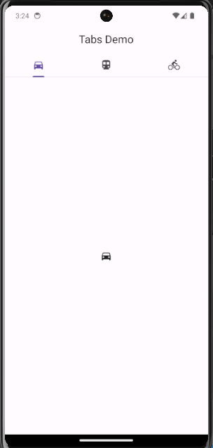
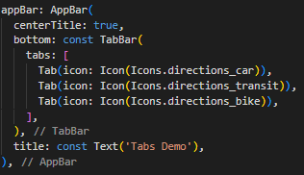
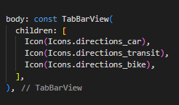
Building a Tab Bar for Navigation
Tabbed Navigation
Organizes content into distinct tabs for easy switching
Provides a clear overview of the app's structure
Enhances user navigation and content management
DefaultTabController
Manages the tab bar state and tab selection
Keeps track of the current selected tab
Updates the UI based on tab selection
TabBar
Creates the tab bar UI and defines tab labels
Displays the tabs and their corresponding icons
Handles tab selection events
TabBarView
Displays the corresponding content for each selected tab
Switches between content widgets based on tab selection
Manages the visibility of content widgets
Notes:
Building a Tab Bar for Navigation
Tabbed Navigation
Organizes content into distinct tabs for easy switching
Provides a clear overview of the app's structure
Enhances user navigation and content management
DefaultTabController
Manages the tab bar state and tab selection
Keeps track of the current selected tab
Updates the UI based on tab selection
TabBar
Creates the tab bar UI and defines tab labels
Displays the tabs and their corresponding icons
Handles tab selection events
TabBarView
Displays the corresponding content for each selected tab
Switches between content widgets based on tab selection
Manages the visibility of content widgets

Slide 7
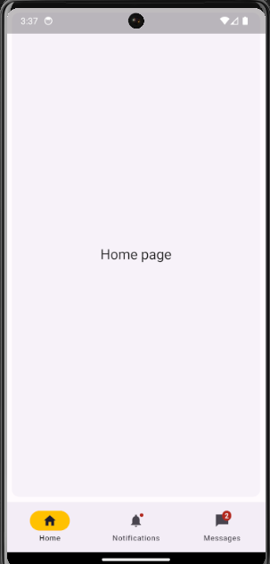
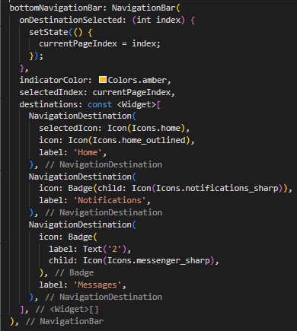
Implementing a Bottom Navigation Bar
.
Bottom Navigation Bar
Provides easy access to primary navigation options
Positioned at the bottom of the screen for easy accessibility
Offers a consistent way to navigate between main app sections
Scaffold
Integrates the bottom navigation bar into the app structure
Provides a layout for the app's content and navigation elements
Defines the position and behavior of the bottom navigation bar
BottomNavigationBar
Defines the bottom navigation bar UI and navigation items
Displays the navigation items and their corresponding icons
Handles navigation item selection events
BottomNavigationBar
Creates individual navigation items with icons and labels
Defines the appearance and behavior of each navigation item
Provides a consistent style for navigation options
Notes:
Implementing a Bottom Navigation Bar
Bottom Navigation Bar
Provides easy access to primary navigation options
Positioned at the bottom of the screen for easy accessibility
Offers a consistent way to navigate between main app sections
Scaffold
Integrates the bottom navigation bar into the app structure
Provides a layout for the app's content and navigation elements
Defines the position and behavior of the bottom navigation bar
BottomNavigationBar
Defines the bottom navigation bar UI and navigation items
Displays the navigation items and their corresponding icons
Handles navigation item selection events
BottomNavigationBar
Creates individual navigation items with icons and labels
Defines the appearance and behavior of each navigation item
Provides a consistent style for navigation options

Slide 8

Advanced Navigation Techniques
Nested Navigation
Handling navigation within routes for complex UI hierarchies
Creating nested navigation structures for hierarchical app layouts
Managing navigation within specific screens or modules
RouterDelegate and RouteInformationParser
Implementing custom navigation logic
Defining custom navigation behavior beyond default navigation patterns
Handling complex navigation scenarios and deep linking
Animation and Transitions
Enhancing navigation with smooth
Notes:
Nested Navigation
Handling navigation within routes for complex UI hierarchies
Creating nested navigation structures for hierarchical app layouts
Managing navigation within specific screens or modules

